Slide 1
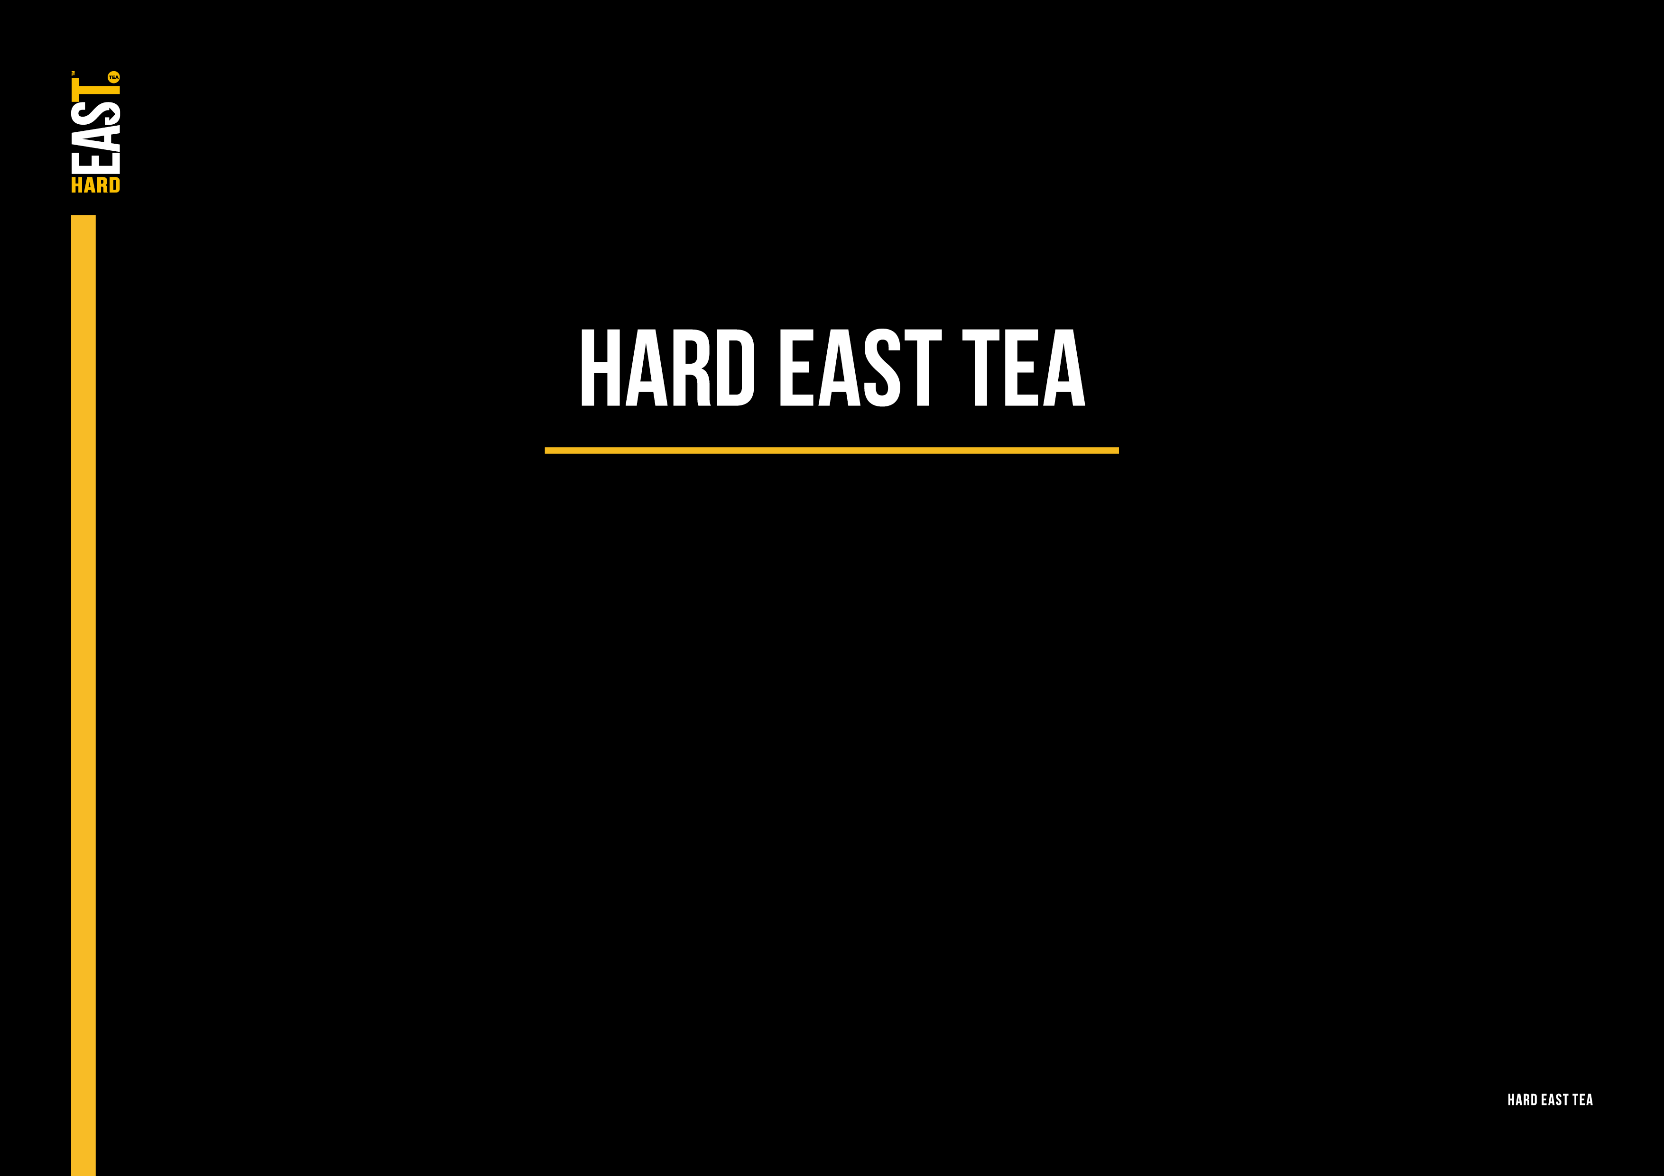
Design Refresh Brief
MABIC November 2018

Slide 2
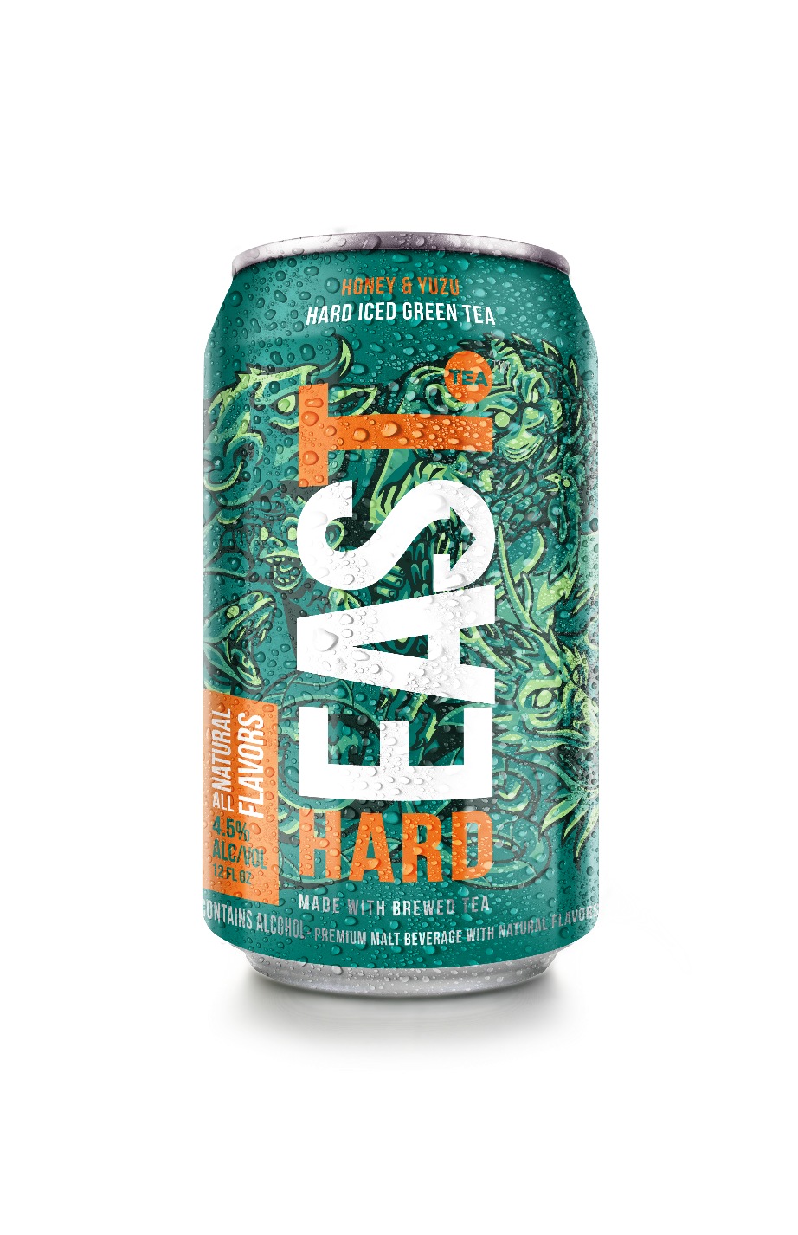
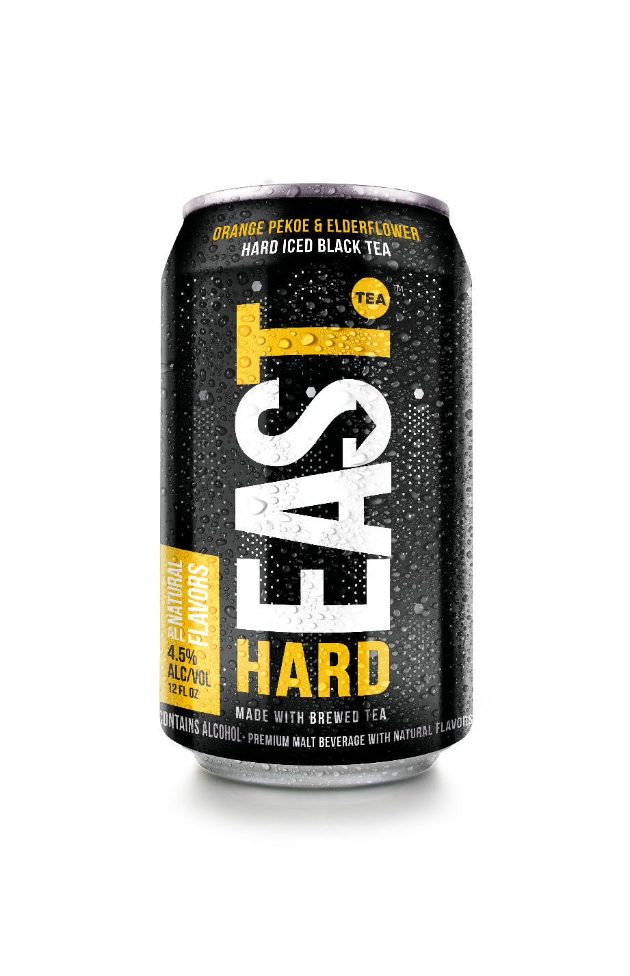
Background
Hard East Tea (HET) is a pioneer BFY spiked Iced Tea brand developed to tap into the large Iced Tea opportunity in the US, which is currently dominated by one key player, Twisted Tea.
Launch: HET pilot launched in select markets June 2018; Seattle, Boisse & Montana (all BFY tea markets and strong White Claw markets).
Notes:
HET is the first of its kind in the category and since launch, there have been a number of similar ‘BFY’ tea products launched.

Slide 3
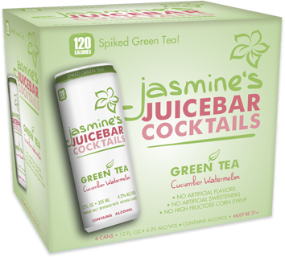
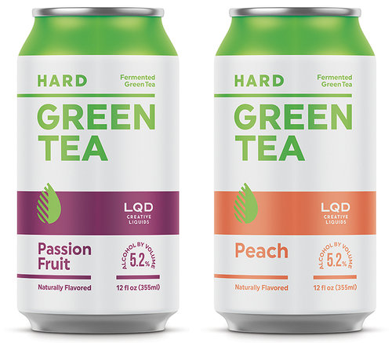
The Launch: What We Learned
Although the packaging of HET is visually striking and appeals to our target consumers, there are some key features that need to be optimized in order to win:
Clearly call-out product proposition - There is confusion as to what this is: soda, energy drink, craft cider? Could we visually reference tea on pack for example?
Better-for-You attributes need to be established with more clarity.
Communicate product flavors.
Differentiate Hard East Tea from other hard teas, like Twisted.
Communicate calorie count – only130* calories
In addition, new competitors are starting to join the market, with similar product propositions as Hard East Tea. Therefore, it is crucial we double down on our BFY positioning as a brand.
* Calorie count TBC, will range between 115-130 cals.

Slide 4
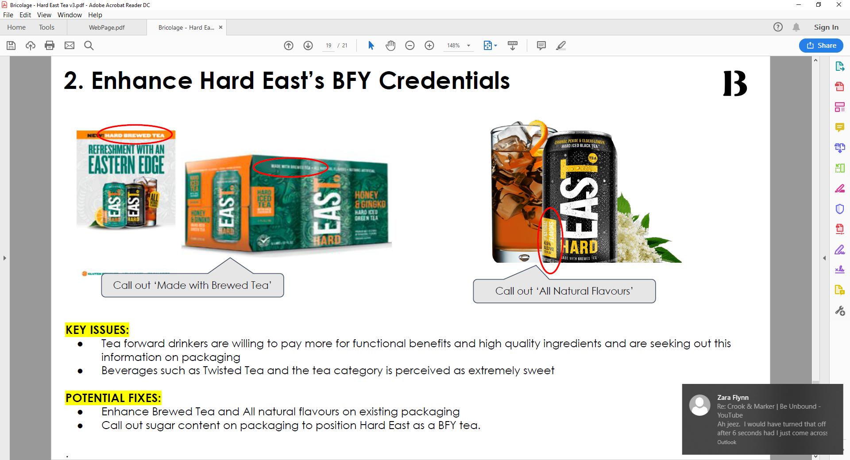
Pack Jobs To Be Done
Product proposition call-out: reference tea on pack.
Enhance HET BFY Credentials: Brewed tea is a key USP for HET, most competitors use artificial tea powders. No artificial flavours.
Visually communicate the flavours: Fruit, the tea in a glass?
How do we suggest refreshment cues?
How do we enhance the low calorie USPs to further underpin our BFY positioning?
Hard East colour coding needs to stand out more on shelf space.
Notes:
Format change: Transition from existing classic can to a slim can (White Claw format).

Slide 5
The Ask
Develop 2-3 x pack refresh options, addressing key pack JTBD (ref. p4).
Format: Please address this refresh with the existing classic can format, but also deliver one slim can pack option.

Slide 6
APPENDIX

Slide 7
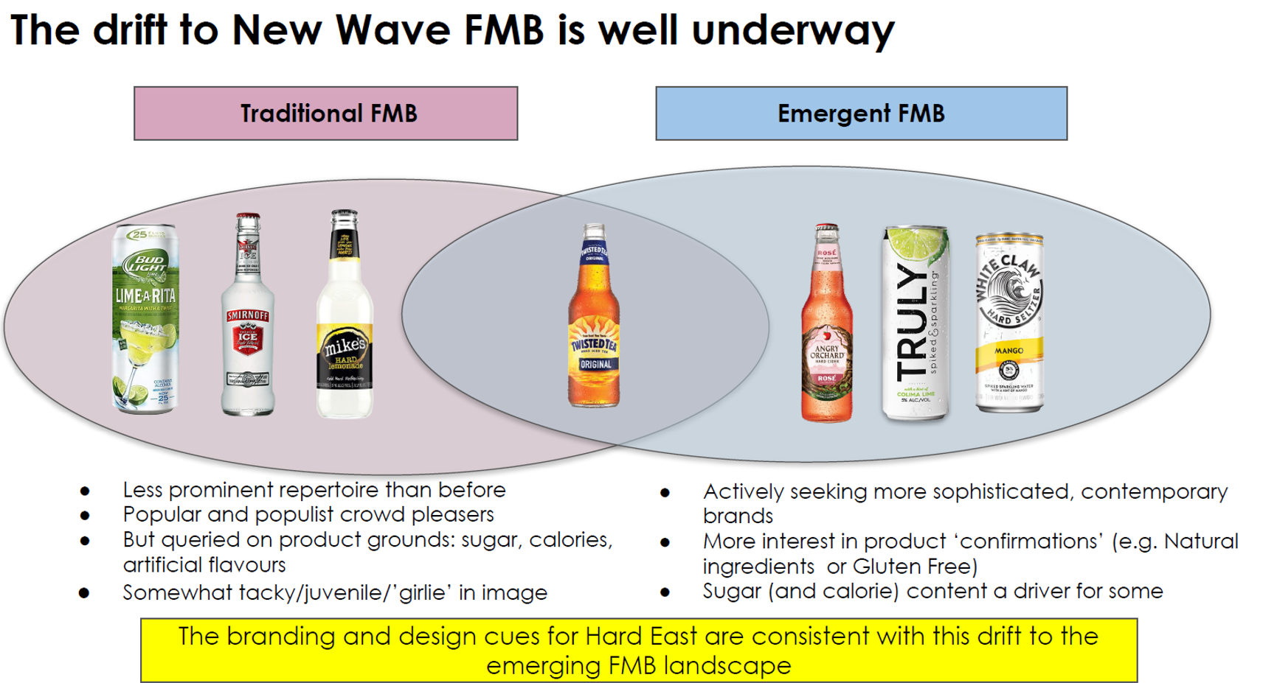

Slide 8
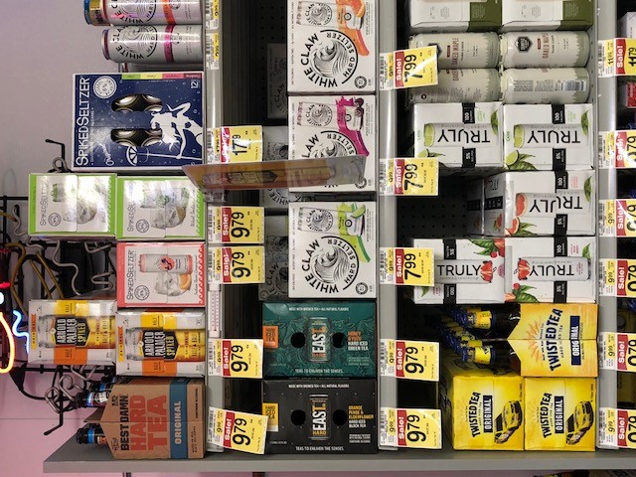
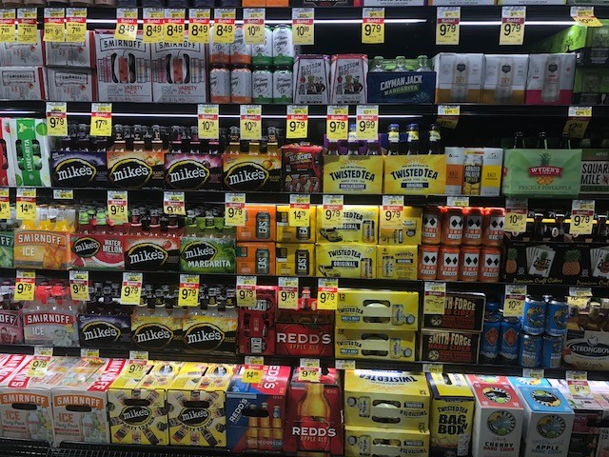
On shelf visibility
Observation: For the Orange Pekoe & Elderflower Black Tea, the current yellow side panel blends in too much with Twisted Tea on shelf.
How do we distinguish ourselves? Competitive set; Arnold Palmer, Twisted Tea, BFY FMB brands.
Recommend placement: Next to Hard Seltzers and craft ciders.

